Slide 1
Lets look at another heart figure I have built with dough…will it glow?
Notes:
Who thinks this heart figure I have made will glow when I plug the wires in?

Slide 2
Conductive and Insulating
CONDUCTIVE - a property of a material that allows current to flow through it easily
Our “conductive dough” therefore will conduct current for our circuits, as it is made with salt, a conductive material!
INSULATED - a property of material that does not allow current to flow through it easily. This is the opposite of conductive.
Our “insulating dough” will therefore not conduct current because it is made with sugar, an insulating material!
Notes:
In order for circuit to work the current has to go through a conductive material.
Here we have two circuits made with playdough in a heart shape. Both look exactly the same right? The reason for the LED not lighting up is because this circuit is made of INSULATING dough, while this is made with CONDUCTIVE dough. Since it is conductive dough, what does that means. That means that the dough allows CURRENT to flow through it easily. Our INSULATING dough does not allow current to flow through it easily. Since no current can flow, the LED won’t light up.

Slide 3
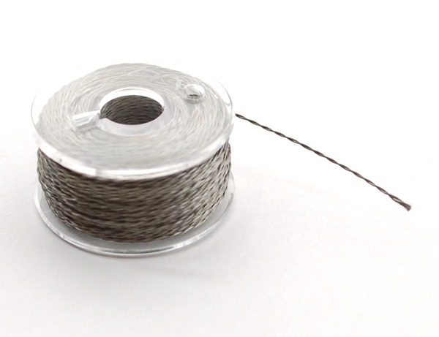
Metal wire is conductive.
Notes:
Now we know, that not everything allows current to flow through it. Some materials are conductive and insulating. Is a metal wire conductive or insulating? CONDUCTIVE.
Wires are surrounded by plastic which are insulating, but the ends are made of conductive metal.

Slide 4
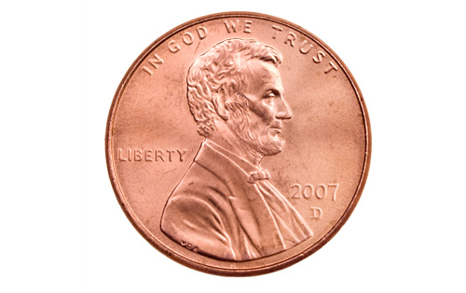
A penny is conductive.
Notes:
Is a penny conductive or insulating?

Slide 5
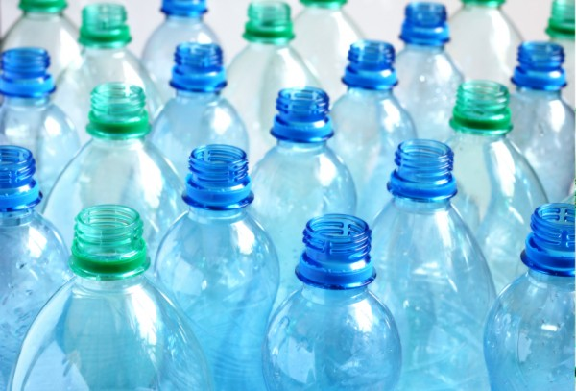
Plastic is insulating.
Notes:
Is plastic conductive or insulating?
Clothes are also conductive.

Slide 6
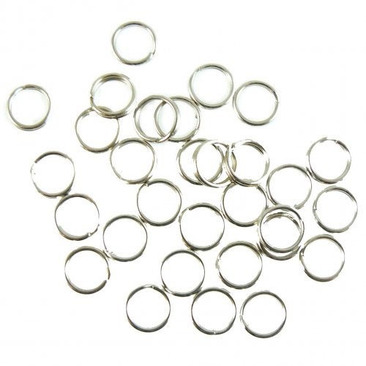
Key chain loops are conductive.
Notes:
Are keychain loops conductive or insulating?

Slide 7
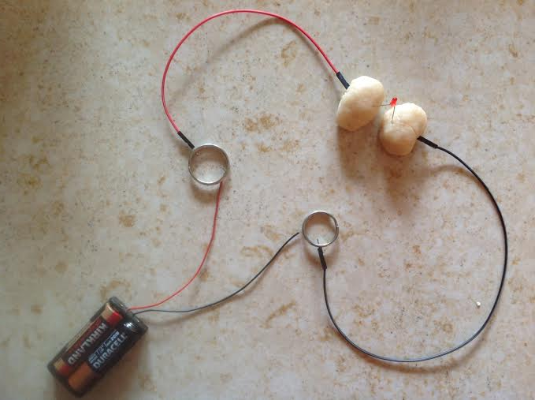
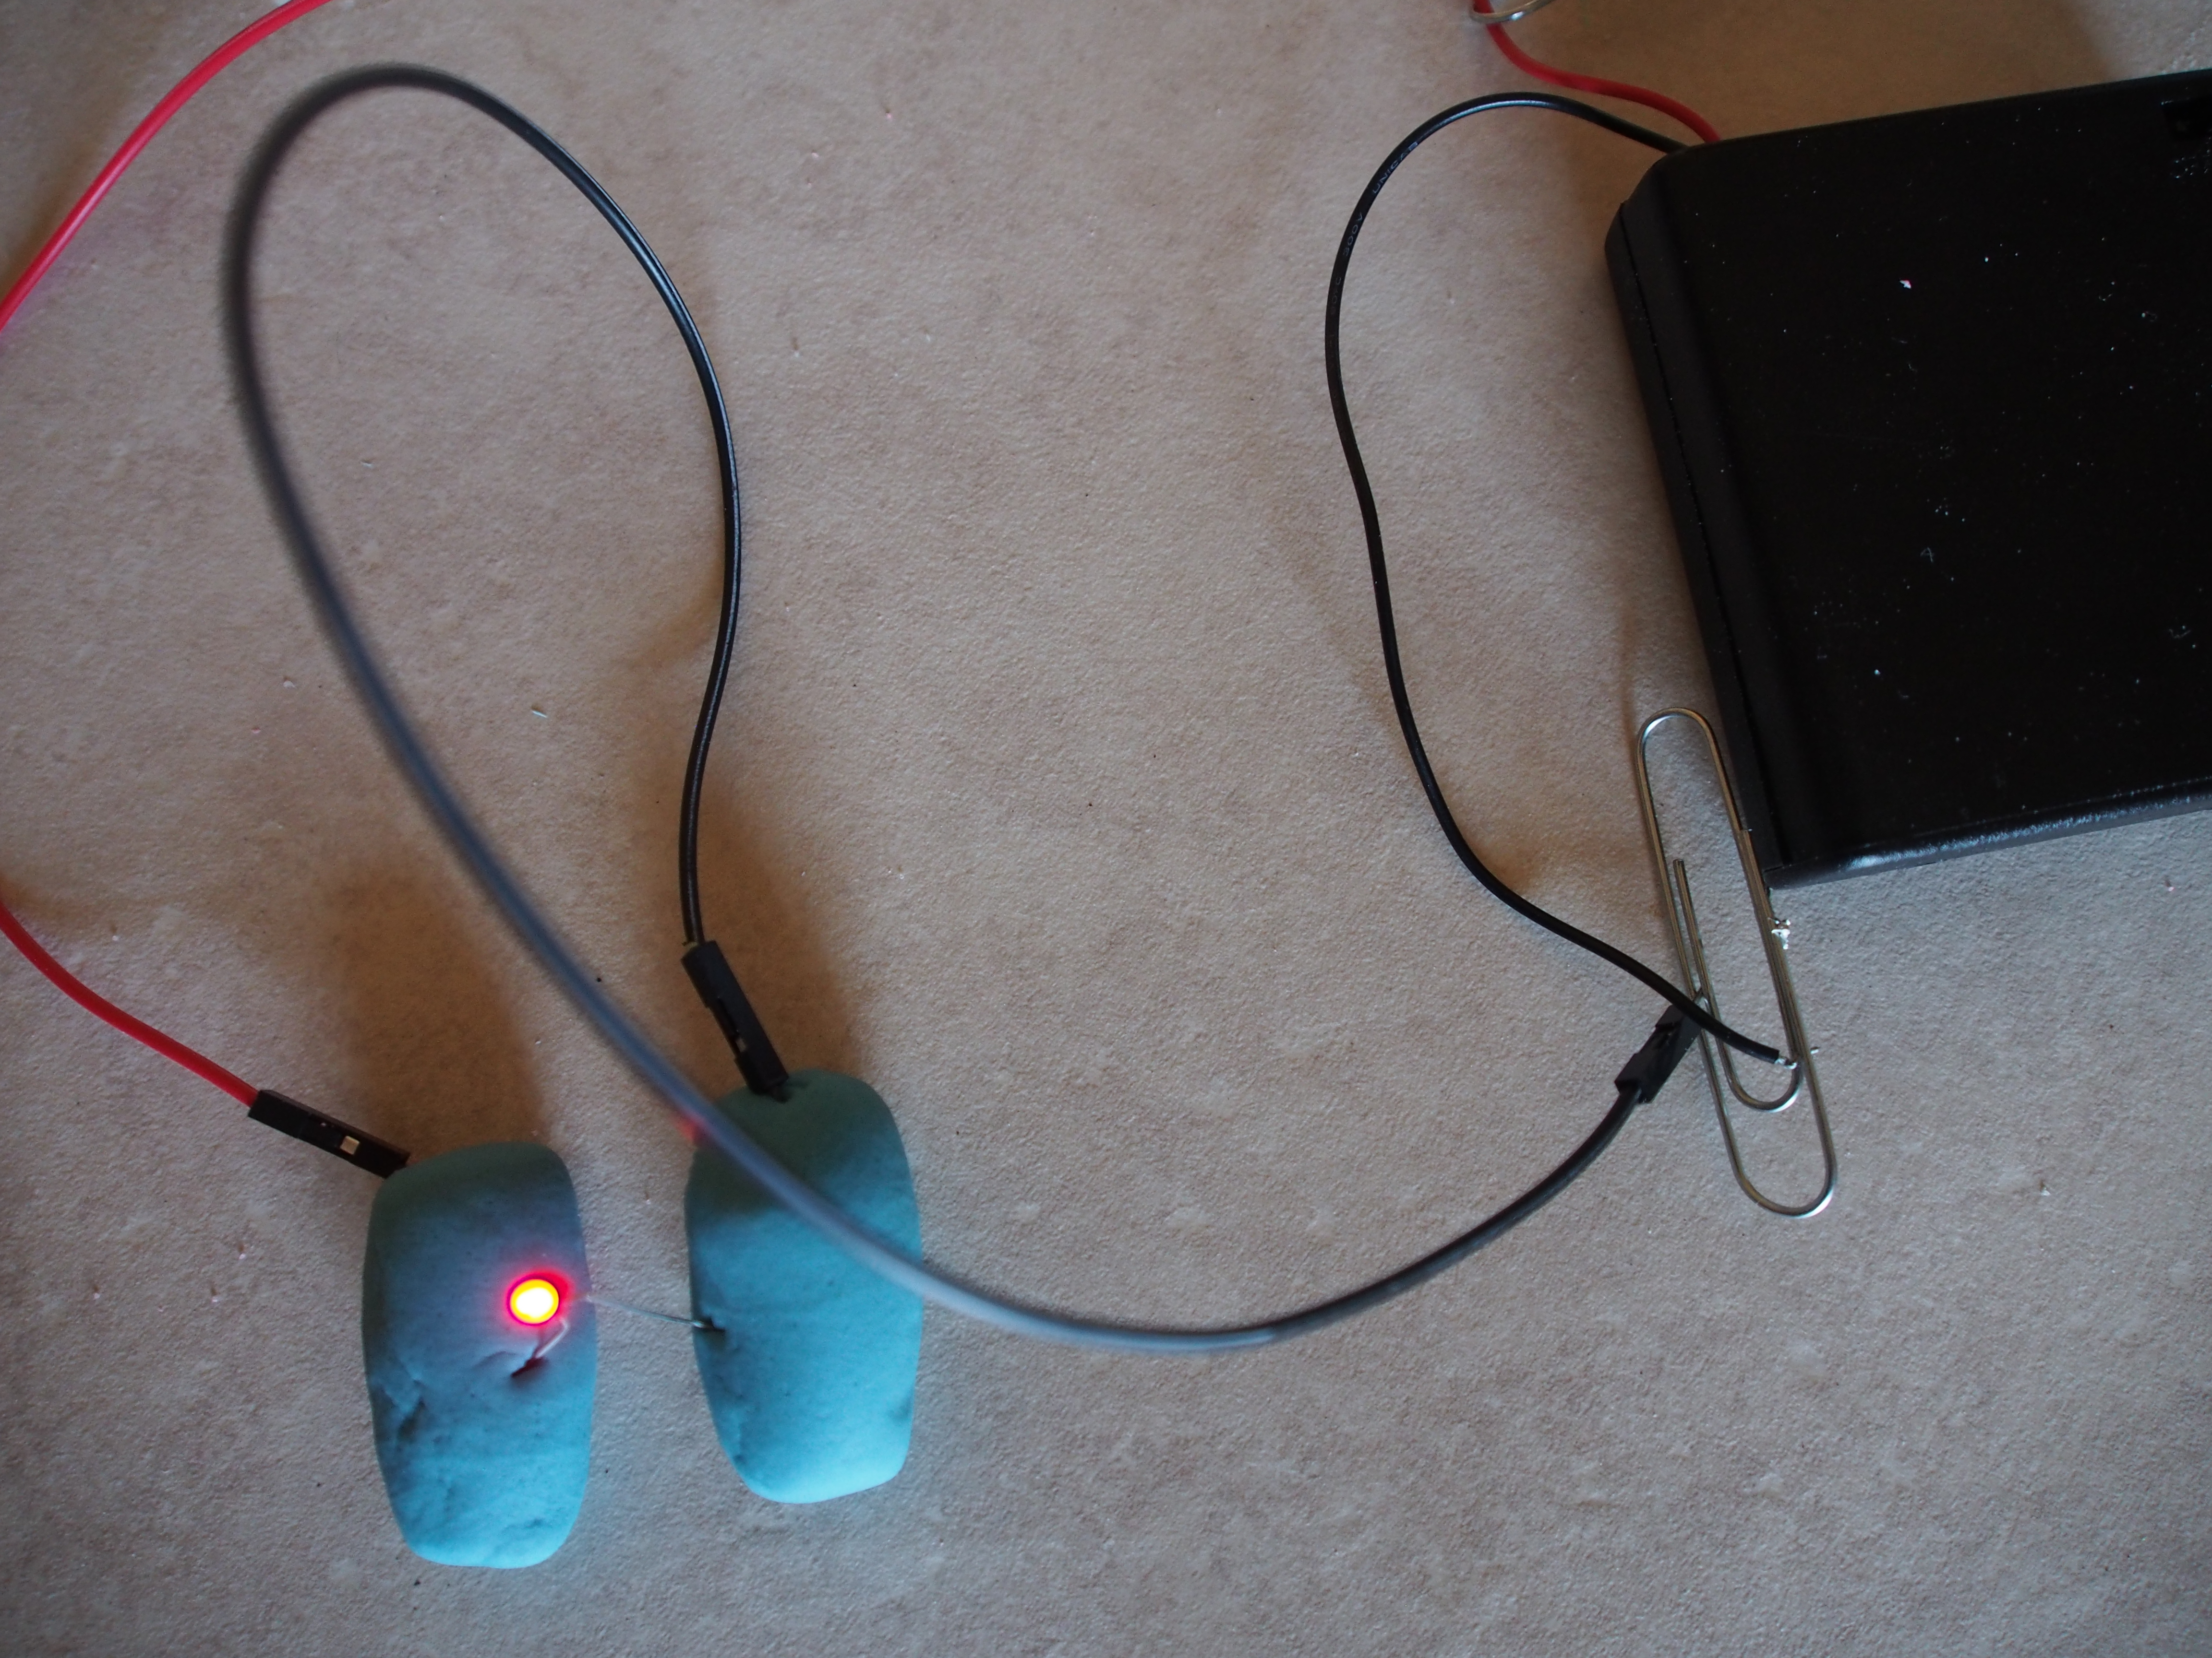
Circuit made with insulating dough.
Same exact circuits, same design. However, only the circuit made with the conductive dough lights up. The LED in the circuit made with insulating dough does not light up!
Circuit made with conductive dough.

Slide 8
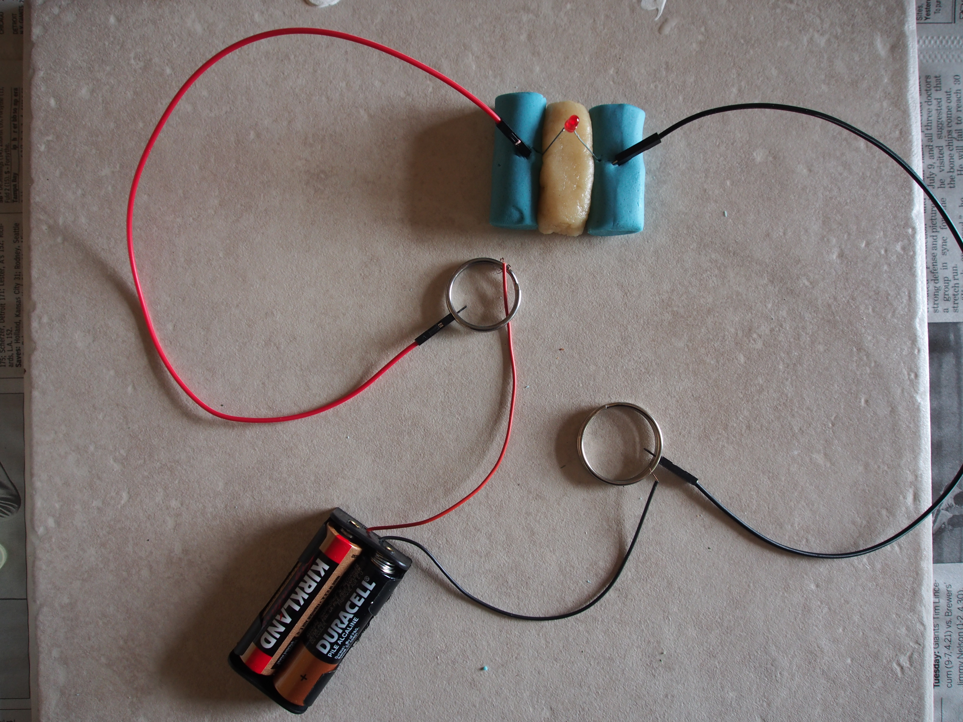
Since the wires attached to the battery holder are short, we have provided each of you with 2 conductive key chain loops. You can attach your wires to the loops and add more wires to the loop.
Notes:
Since the wires attached to the battery holders are short, we have provided everyone with 2 conductive key chain loops. You can attach your wires to the loops and add more wires to the loop. Since keychain loops are conductive, the current can still flow through the keychain loops!
Also, in this picture you can see that there is white insulating dough in the middle of my very simple circuit. Why do you put insulating dough in the middle?
It is not necessary to put insulating dough between the 2 pieces of conductive dough, but I have chose to put the dough. You cannot however have the two pieces of blue dough touching. The insulating dough is a barrier between the positive and negative connected dough. If you connect the two doughs the current will go through just the dough and not the LED. The LED will just be left there standing with no current flowing through it. The current always takes the shortest path or path of least resistance.

Slide 9
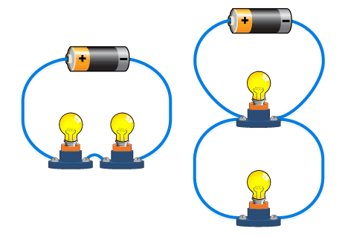
Series Circuits
Electrical circuits can be connected in many different ways
The two simplest ways are series and parallel
Components connected in series are connected along a single path, so the same current flows through all of the components
Remember, series = 1 LOOP
Notes:
Lastly, circuits can be connected in many different ways. The two simplest ways are series and parallel. Components connect in a series are connected along a single path, so the same current flows through all the components. Series circuits have 1 LOOP.

Slide 10
Parallel Circuits
Components connected in parallel are connected so the same voltage is applied to each component.
Remember,parallel = 2 LOOPS or MORE
Notes:
Components connected in a parallel are connected so the same voltage is applied to each component.
In a parallel circuit, if you remove a LED the other LEDs will still light up. Parallel circuits have 2 or more LOOPS.

Slide 11
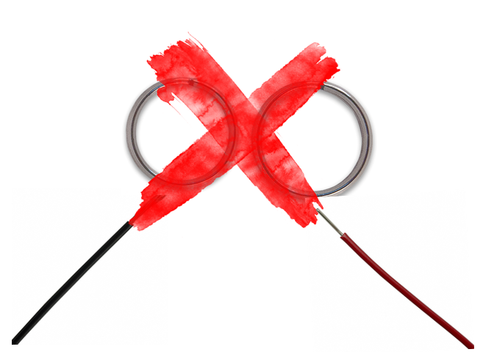
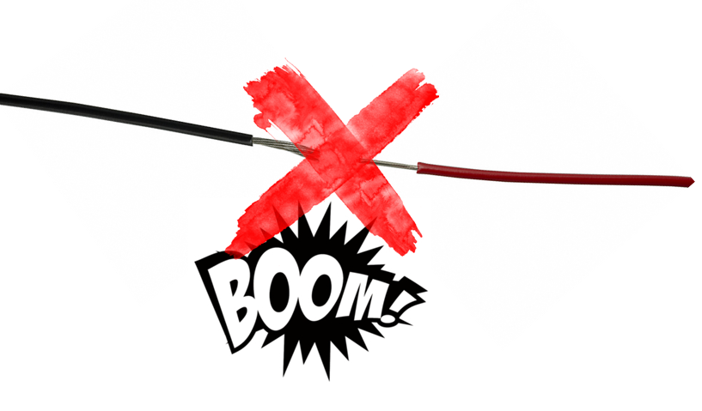
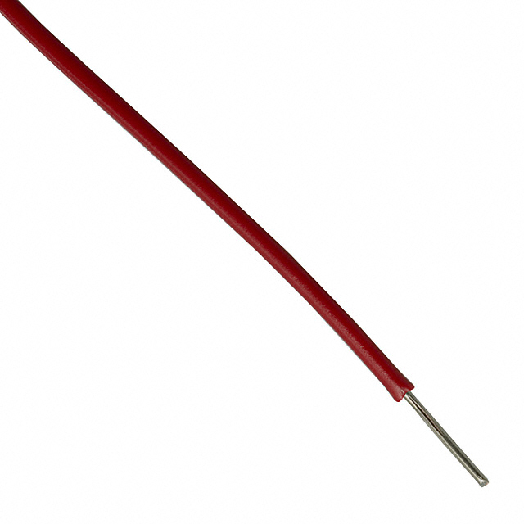
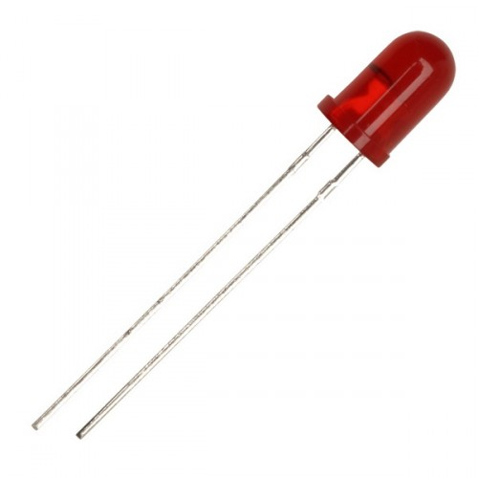
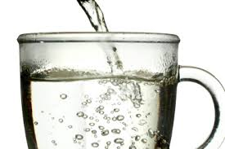

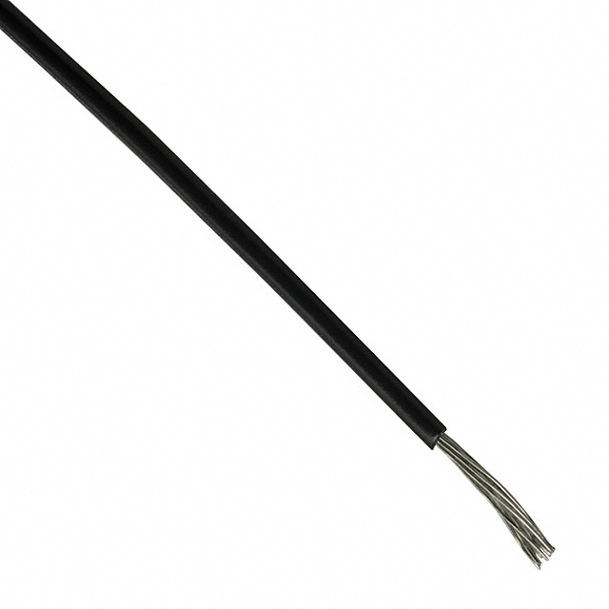
Safety Rules
When your batteries are in your pack, make sure the two keychain loops do not touch at all!
NEVER connect the ends of wires directly to each other!
Ask for a volunteers help with the hot water!
Do not connect the LEDs directly to the wires without using playdough!
Notes:
Never connect the ends of wires together; this is called a short circuit and can make the batteries and wires get very hot and burn out!
Do not connect the LEDs directly to the wires without using play dough; this will burn out the LEDs.
When your batteries are in your battery pack, make sure the two key chain loops do not touch at all! If you are not using you batteries at the moment, take 1 out so you don’t have to worry about the key chain loops touching or wires touching.
Ask for a volunteer's help when mixing in the hot water.
When storing your dough at home, place it in an airtight container and in the refrigerator. Your dough may get moldy after a few days, which is perfectly normal. Just throw it away and make more!

Slide 12

TEAM RED
red conductive dough
TEAM BLACK
TEAM YELLOW
insulating dough
black
conductive dough
Yellow
conductive dough
insulating dough
insulating dough
TEAM BLUE
blue
conductive dough
green
conductive dough
TEAM GREEN
insulating dough
insulating dough
Notes:
> Each team will make white insulating dough and the conductive dough of their team color. > You will need more colors besides your team color. > More dough will be provided after you have finished cooking. That dough I have already made at home, but with a stove. > We cannot cook the dough here with a stove but if you try at home, cook the dough on a stove! (It turns out better!)

Slide 13
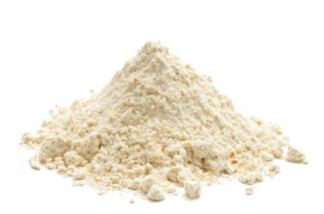
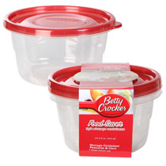
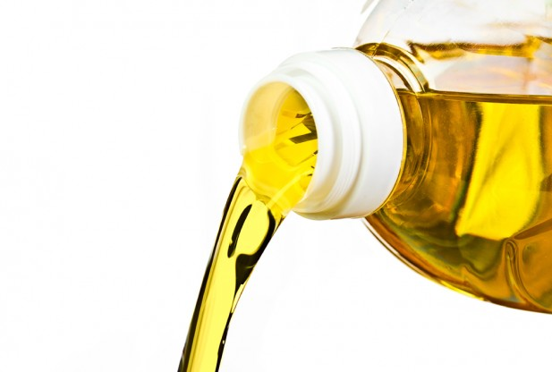
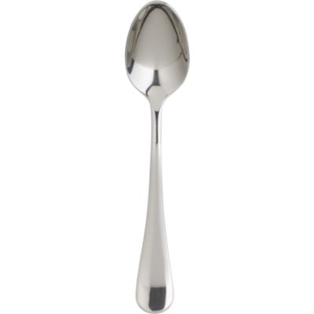
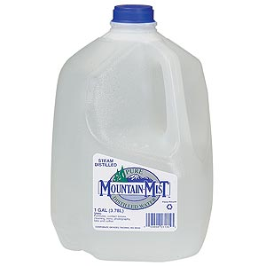
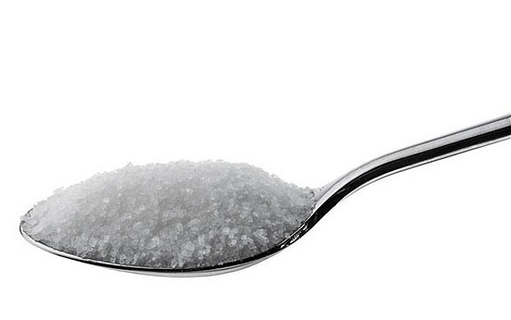
Recipe for Insulating Dough
1 ½ cup flour
3 tbsp. vegetable oil
6 tbsp. distilled water
½ cup sugar
Notes:
All the material for your group is already measured and is in the ziploc bags at your tables in the corresponding boxes.
Volunteers will bring you the right amount of warm water/distilled water needed in little cups– don’t worry about that.
1 mixing bowl for the conductive dough and 1 mixing bowl for the insulating dough
If you are hesitant about anything when mixing, ask the volunteers!
Keep your work area clean and be careful! If you spill something, please pick it up!
Also, after you done mixing everything do not throw away ANY of the ziploc bags or cup for water!!!

Slide 14
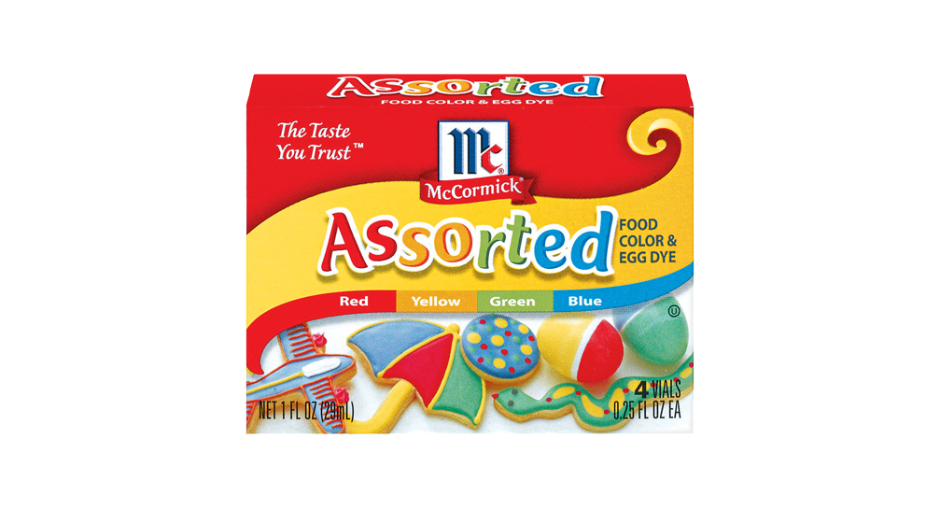
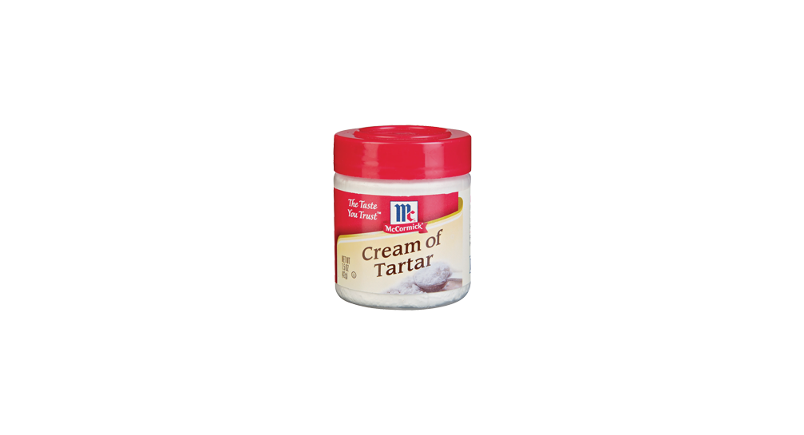
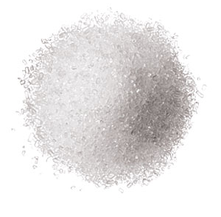
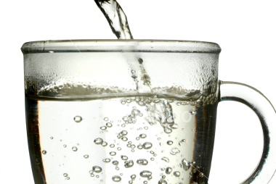
Recipe for Conductive Dough
ABOUT (may be less) 20 drops of food coloring of your team’s color
1 tbsp. vegetable oil
1 ½ cup flour
¾ cup water
3 tbsp. cream of tartar
¼ cup salt
Notes:
Mix food coloring with water before pouring

Slide 15
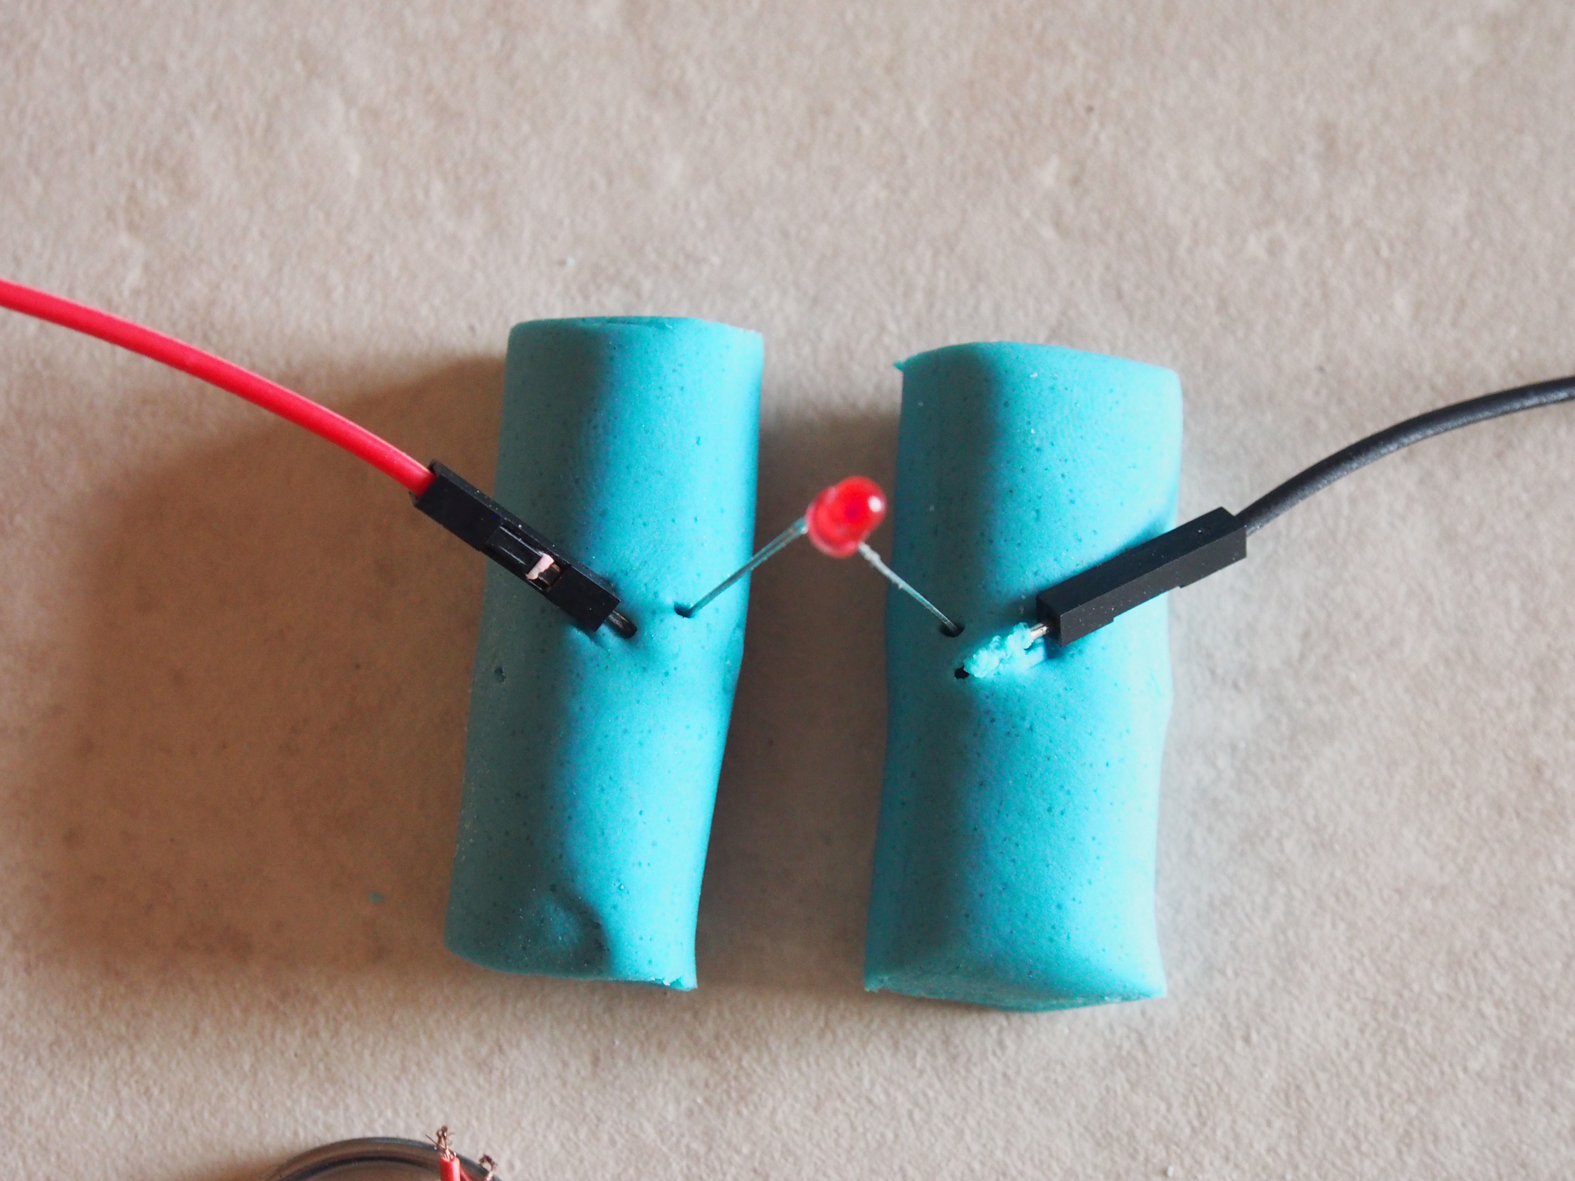
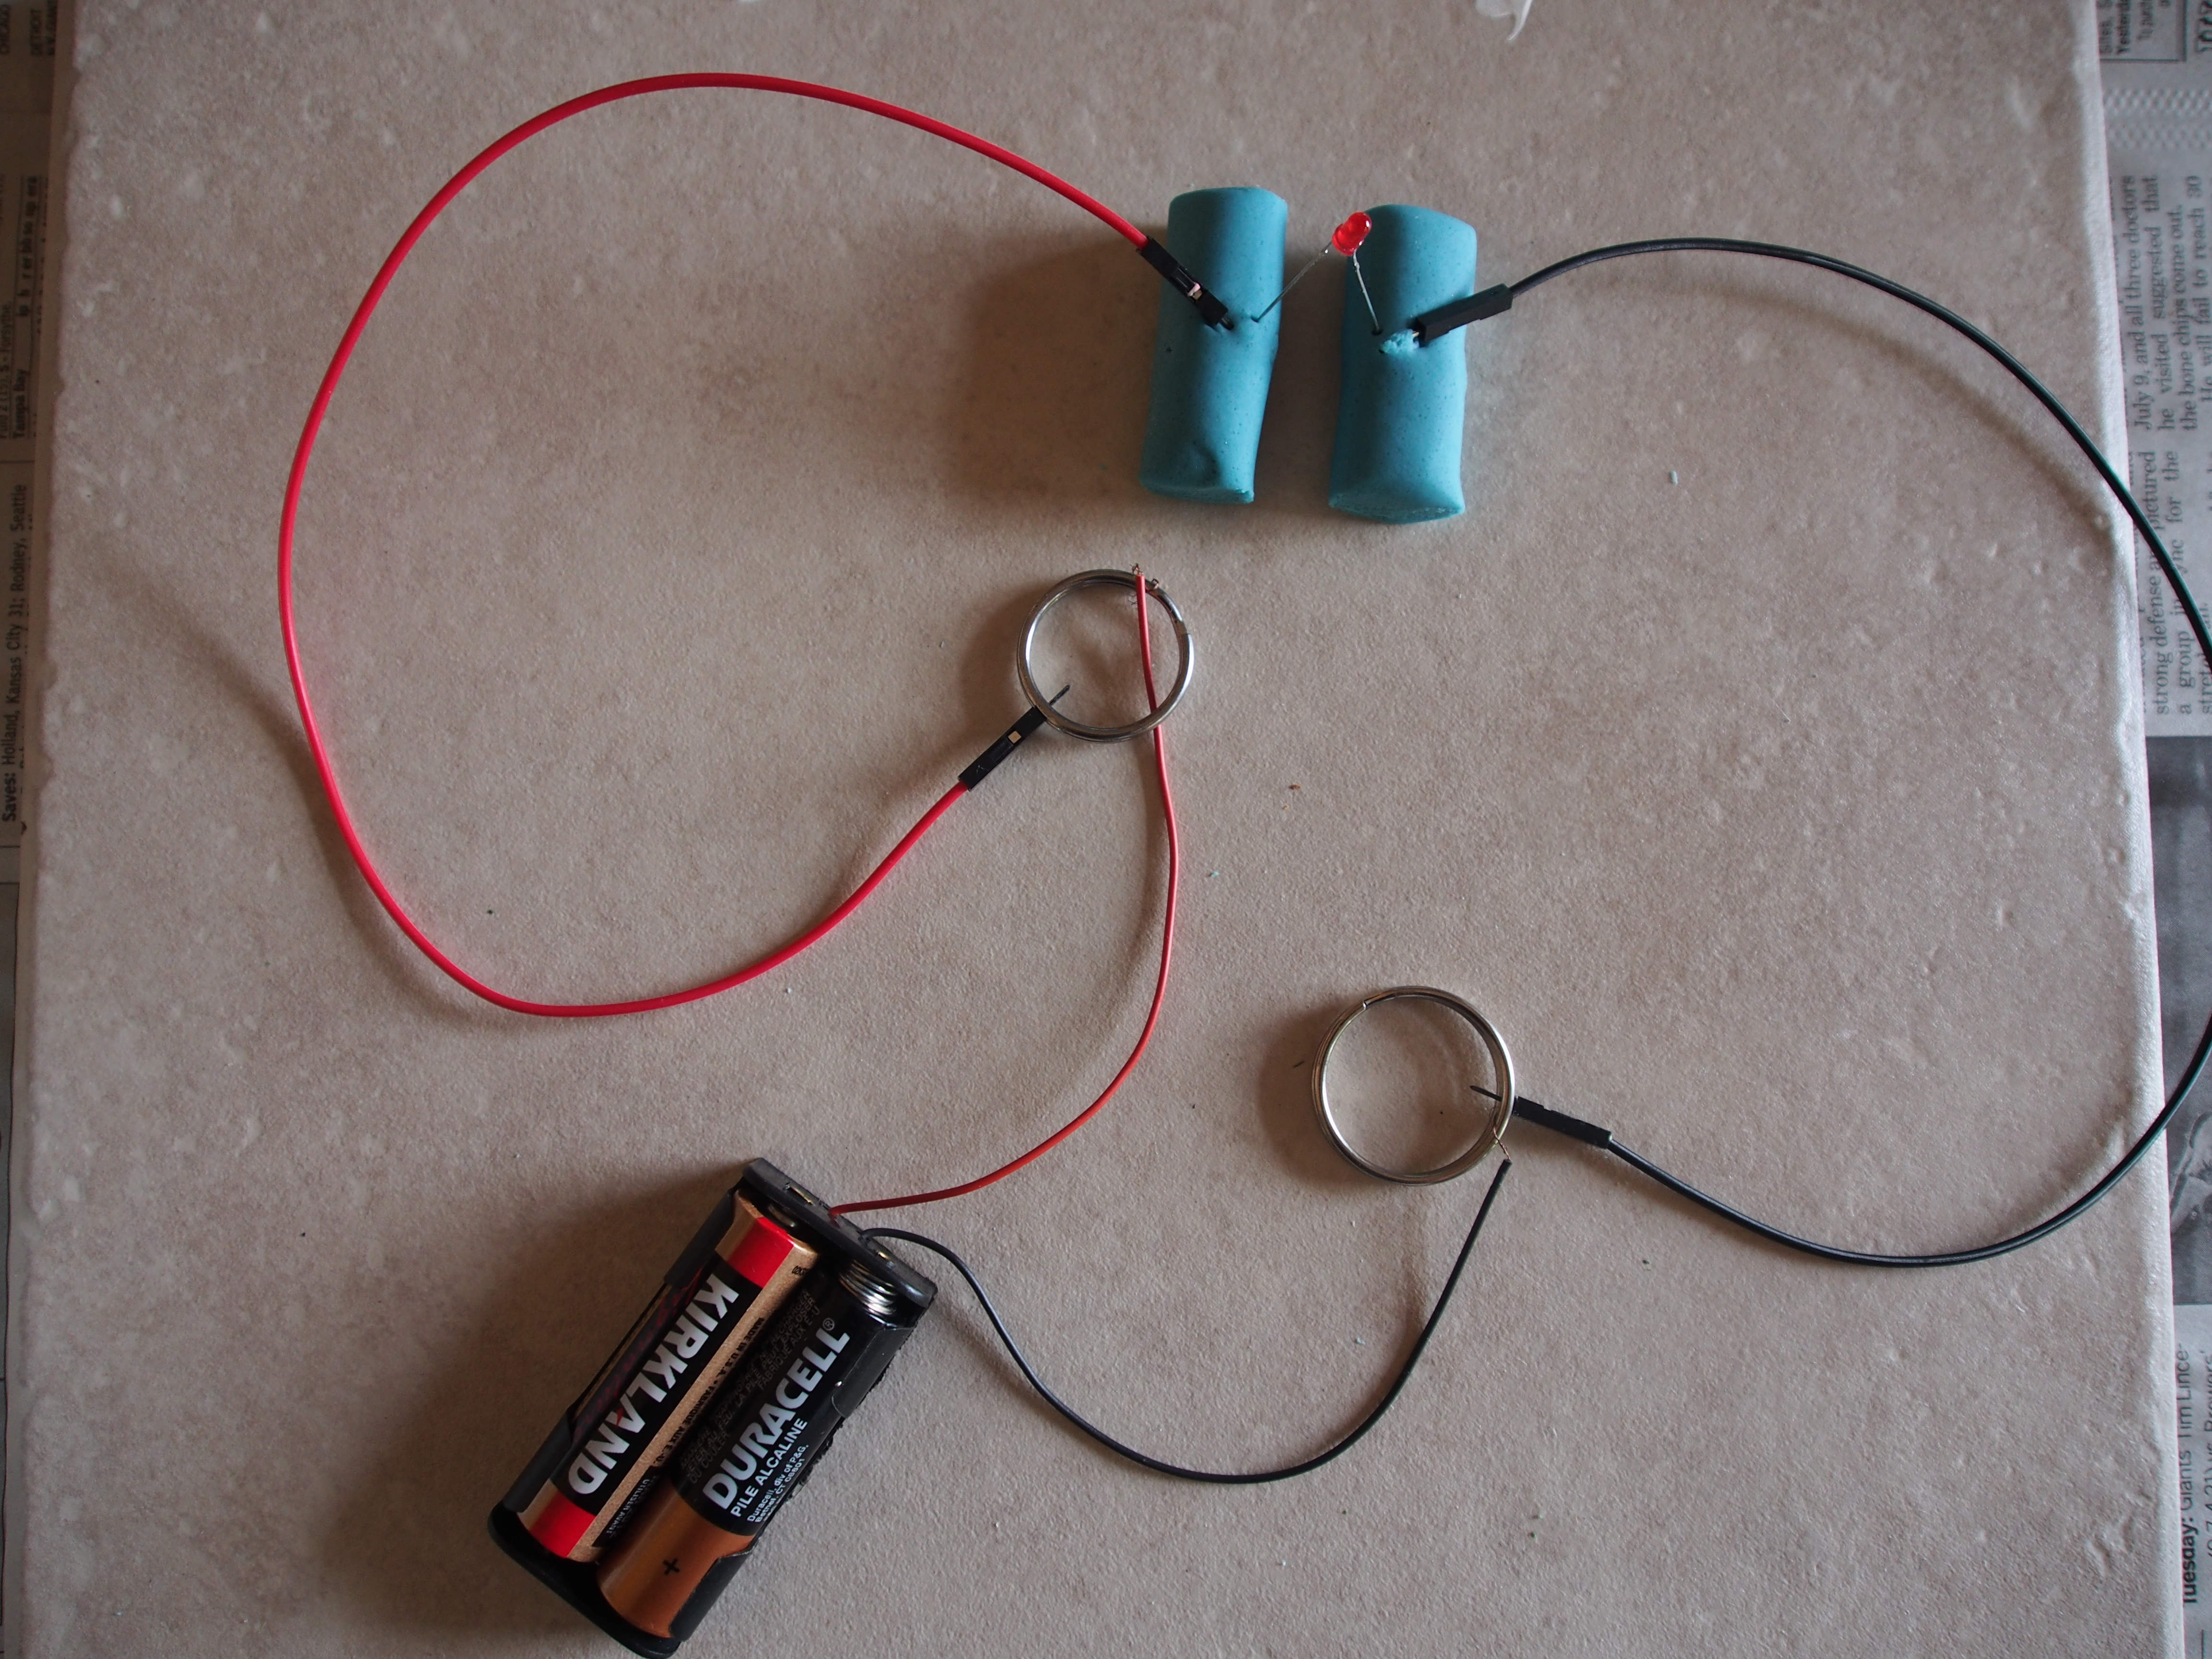
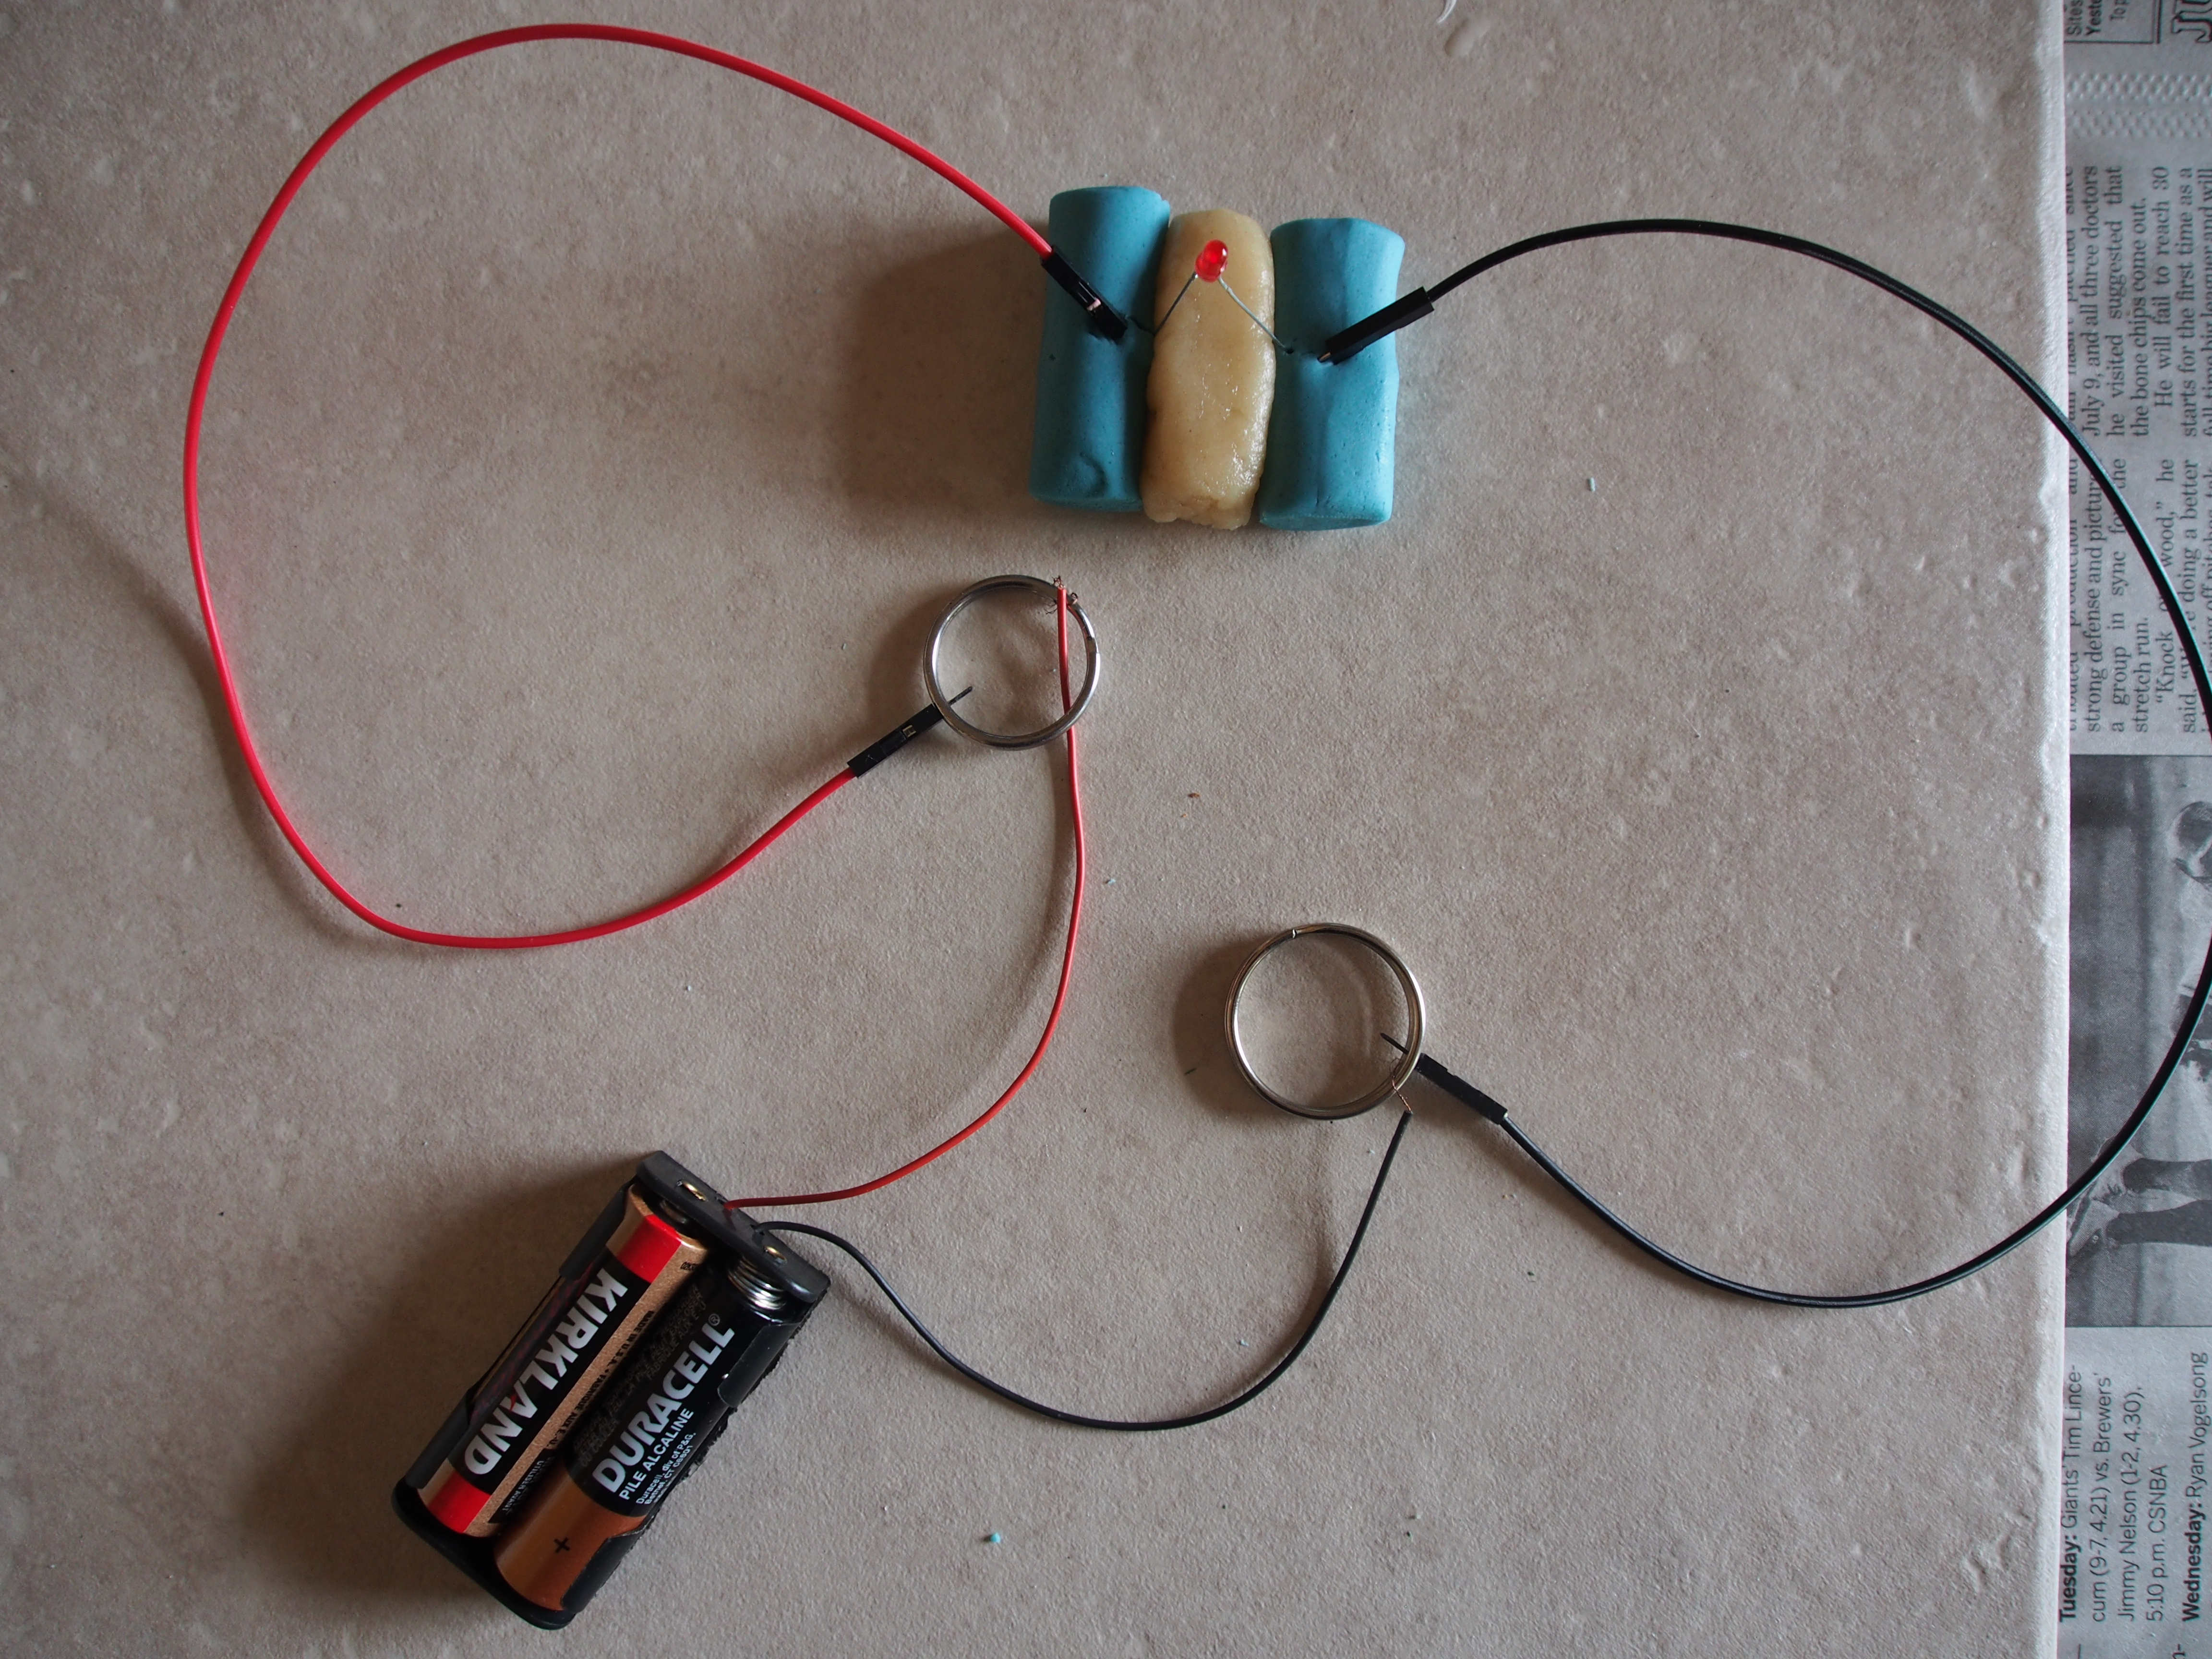
Ski Man Activity #1
What you need:
1 color of conductive dough(any color, up to you what you want)
white insulating dough(optional)
1-3 LEDs
Notes:
Challenge: Ski man parallel or series?

Slide 16
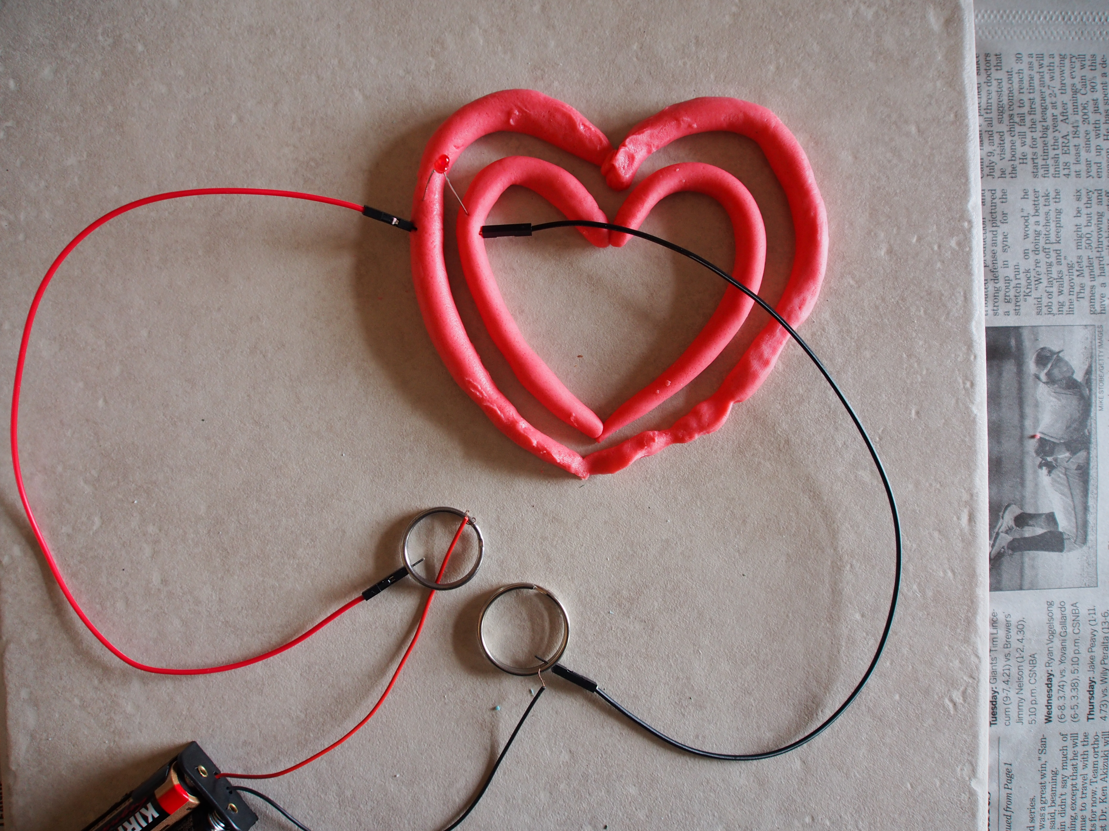
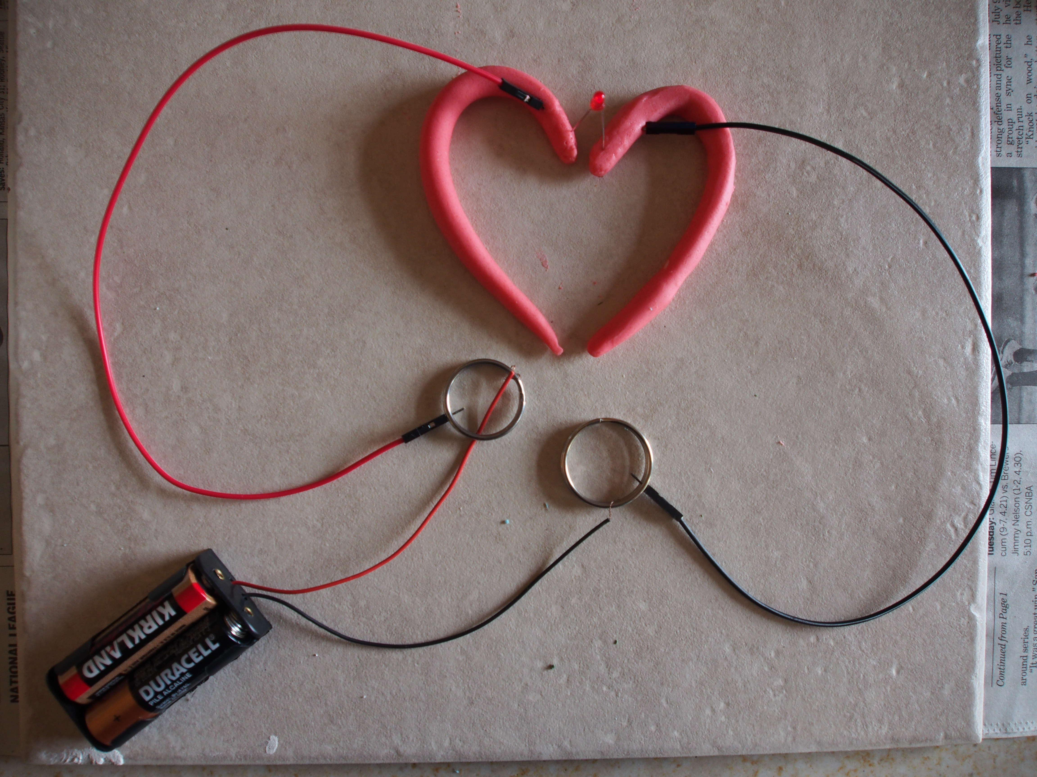
Simple Heart Activity #2
What you need:
1 color of conductive dough(any color, up to you what you want)
1-5 LEDs, depending on preference on how you want to light up your heart outline

Slide 17
